Slide 1
Case Study 2: Fine Dining Restaurant
By: Fox Wihlborg, Quashawn Turner, and Silvana Barrera

Slide 2
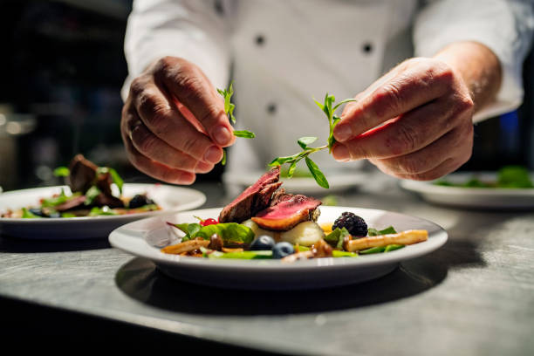
Business Idea: Fine Dining Restaurant
10 Steps for starting a fine dining restaurant
Plan business
Form a legal entity
Register for taxes
Open business account
Set-up accounting
Obtain permits/licenses
Obtain business insurance
Define brand
Create website
Business phone set-up
(TRUic, 2021)

Slide 3
What are our fixed and variable costs?
Fixed costs include rent, mortgage, salaries, loan payments, license fees, and insurance premiums. These costs are easier to budget for when opening a restaurant because they don’t fluctuate much each month.
Variable costs include food, hourly wages, and utilities. These costs are harder to predict when opening a restaurant because they vary according to output. After several months, you’ll know what to expect each month (Darlington, 2021).
The following table is utilizing $30 for fixed and variable costs. In addition average market price per meal being $21. TC=FC+VC and Total Revenue=Output*Market Price ($21). Total Profit is found by subtracting TC from TR.

Slide 4
Sample Fixed and Variable Costs Table
Output | 0 | 1 | 2 | 3 | 4 | 5 | 6 | 7 | 8 | 9 | 10 | 11 | 12 | 13 | 14
Fixed Cost | 30 | 30 | 30 | 30 | 30 | 30 | 30 | 30 | 30 | 30 | 30 | 30 | 30 | 30 | 30
Variable Cost | 0 | 12 | 22 | 30 | 36 | 44 | 54 | 66 | 80 | 96 | 114 | 134 | 156 | 180 | 206
Total Cost | 30 | 42 | 48 | 60 | 66 | 74 | 84 | 96 | 110 | 126 | 144 | 164 | 186 | 210 | 236
Total Rev. | 0 | 21 | 42 | 63 | 84 | 105 | 126 | 147 | 168 | 189 | 210 | 231 | 252 | 273 | 294
Total Profits | -30 | -21 | -6 | 3 | 18 | 31 | 42 | 51 | 58 | 63 | 66 | 67 | 66 | 63 | 58

Slide 5
Increasing Marginal Returns
Increasing marginal returns refer to a point where the production of an additional unit with the give unit results to an increase in marginal revenue.
It is indicated by the increase in total profits for each additional output unit.
A positive change in returns for every additional unit produced indicates increasing marginal returns.
There is an increase in marginal returns from producing 1 to11 units of output.

Slide 6
Change in returns
Output | 0 | 1 | 2 | 3 | 4 | 5 | 6 | 7 | 8 | 9 | 10 | 11 | 12 | 13 | 14
Marginal returns | -30 | -21 | -6 | 3 | 18 | 31 | 42 | 51 | 58 | 63 | 66 | 67 | 66 | 63 | 58
Change in marginal returns | -30 | 9 | 15 | 9 | 15 | 13 | 11 | 9 | 7 | 5 | 3 | 1 | -1 | -3 | -5

Slide 7
Constant and diminishing returns
A negative change in marginal returns indicates a decrease in marginal productivity.
This means that a lower level of profit is realized when the restaurant produces an extra unit of output.
There is diminishing marginal returns from each additional unit above the optimum. In this case, units 12, 13, and 14 have diminishing returns.
A constant marginal returns is indicated by a zero change in the level of profits from an extra unit of output.

Slide 8
References
Harris, D. N. (2019). Diminishing marginal returns and the production of education: An international analysis. Education Economics, 15(1), 31-53.
Leroux, J. (2017). Cooperative production under diminishing marginal returns: interpreting fixed-path methods. Social Choice and Welfare, 29(1), 35-53.

